Slide 1

Returning to Seasonal Year Age Group Formation in
2026
Classic, Challenge & Youth Academy
Discussion

Slide 2
Agenda – Competitive & Youth Academy Discussion
01 | Introduction of Topic & Speakers – Kathy Robinson, NCYSA Executive Director
02 | U.S. Soccer Directive & Registration Guidelines for Seasonal Year Age Group Formation: n Jane Llewellyn, State Registrar
03 | NCYSA Classic League n Colby Morton, NCYSA Assistant Director, Classic & State Cups
04 | Best Practice Considerations for DOC/Coaches: n Bill Furjanic, NCYSA Technical Director n John Trice, NCYSA Associate Technical Director, ODP & Youth Academy
05 | Questions

Slide 3
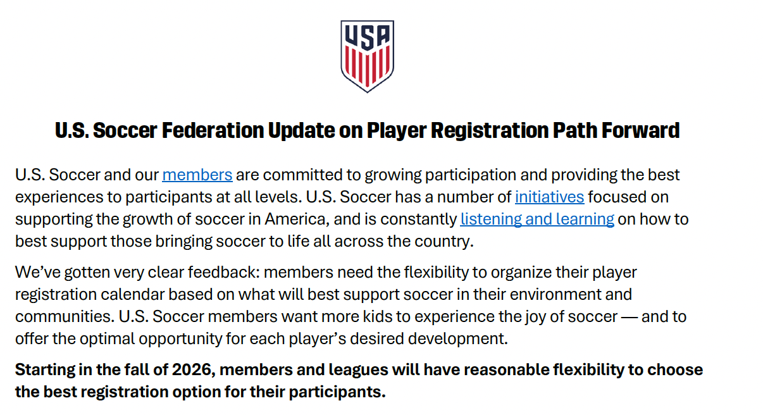

Initial Memo from U.S. Soccer to all members: December 2024

Slide 4

Initial Memo from U.S. Soccer to all members: November 2024
Requested input from members:
US Club, USYS, AYSO, SAY Soccer, the State Associations, Girls Academy,
MLS, USL, NWSL, and USSSA. (15,000 responses)
Recognized:
It’s not practical or optimal to choose one registration choice for the entire ecosystem
Organizing around school year should be a local market / member decision. Many recreation leagues are already using seasonal year.
Key Drivers:
Social benefits, participation & retention, team formation, and managing physical advantages

Slide 5
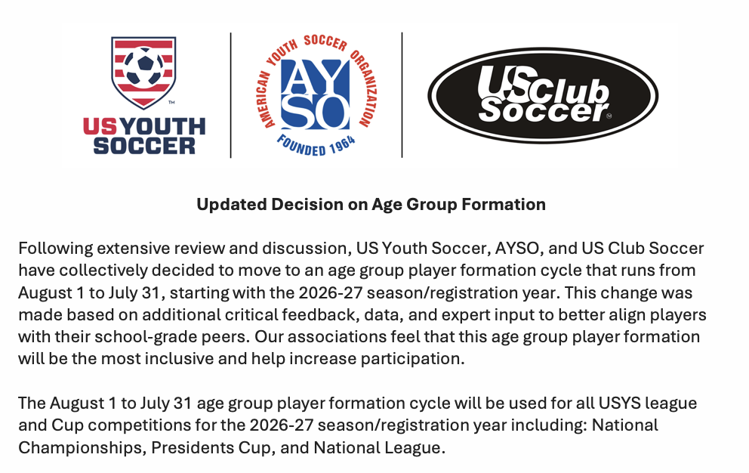
June 2025

Slide 6

Seasonal Year Age Group
Age Group Defined as players born between: August 1st - July 31st
To determine Age Group:
2026 minus August birth year
Example: 2026 – August 2010 = U16
Players born August 1, 2010, through – July 31, 2011, are true U16 players
Players born January – July will advance one year for the 26/27 seasonal soccer year
Players born August – December will remain in their current age group
Current 19U players (Aug - Dec) may return as a U19 for the 26/27 soccer year

Slide 7
Questions to Ask
Between August 1,2026 & July 31, 2027,
How old will the player be?

Slide 8
26/27 Season Year | Age Group (2026-Aug. Birth Year)
8/1/2007 - 7/31/2008 | U19 ( 07)
8/1/2008 –7/31/2009 | U18 (08)
8/1/2009 –7/31/2010 | U17 (09)
8/1/2010 –7/31/2011 | U16 (10)
8/1/2011 –7/31/2012 | U15 (11)
8/1/2012 –7/31/2013 | U14
8/1/2013 –7/31/2014 | U13
8/1/2014 –7/31/2015 | U12
8/1/2015 –7/31/2016 | U11
8/1/2016 –7/31/2017 | U10
8/1/2017 –7/31/2018 | U9
8/1/2018 –7/31/2019 | U8
8/1/2019 –7/31/2020 | U7
8/1/2020 –7/31/2021 | U6

Slide 9
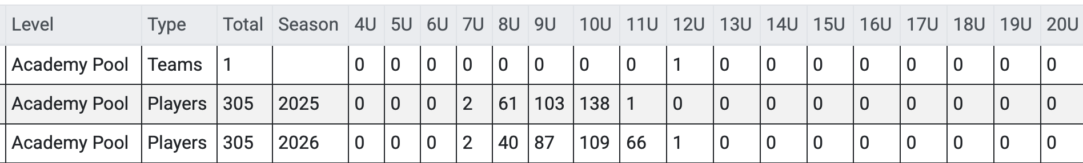
Contact your club Register to run a 26/27 report
Youth Academy Age Summary
Total # players today – 305
2025: Breakdown of current players per age group – using birth year
2026: Breakdown of same players per age using the 26/27 seasonal year chart
NOTE: Zoom sessions were provided Monday, Oct. 27th & 28th for all registrars.
If your registrar was unable to make one of the six (6) class options –
have them contact their NCYSA Liaison for the update.

Slide 10
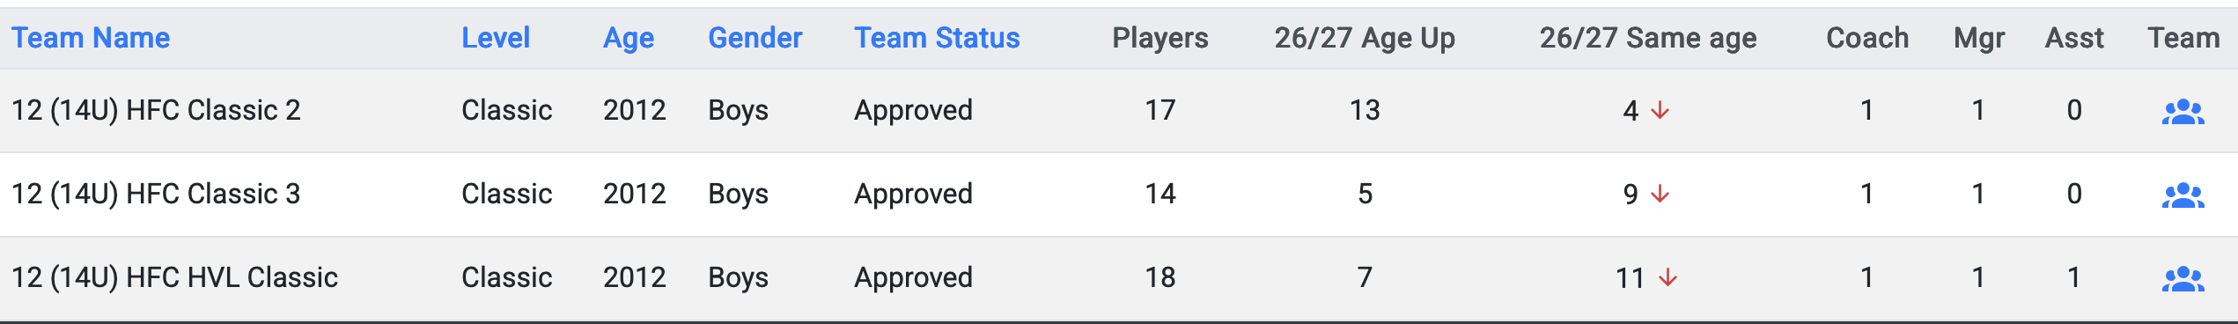
Contact your club Register to run a 26/27 report – Classic Teams
# Registered Players on the team
# Players that will move up an age group for the 26/27 season
# Players that will remain in the same age group for the 26/27 season
NOTE: Zoom sessions were provided Monday, Oct. 27th & 28th for all registrars.
If your registrar was unable to make one of the six (6) class options –
have them contact their NCYSA Liaison for the update.

Slide 11
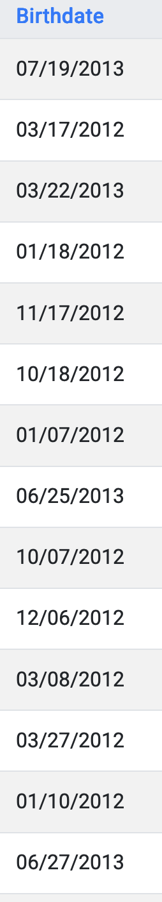
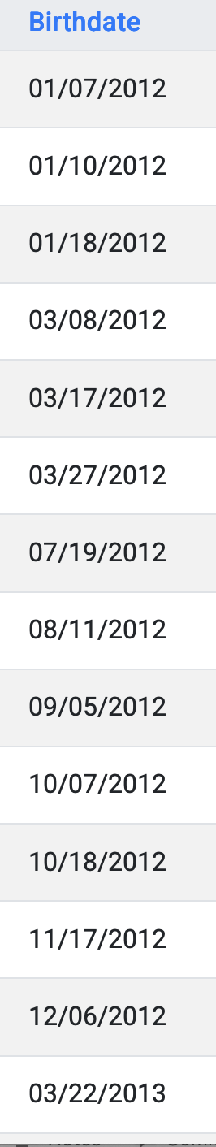
Roster – Alpha Order
Roster by Birthdate
Current 25/26 Roster for a
12 (14U) Team
Players will move up to U15
for the 26/27 seasonal year
Team Age: 8/1/11 – 7/31/12
Sort by Birthdate
Players will remain U14
for the 26/27 seasonal year
Team Age:
8/1/12 - 7/31/13

Slide 12
NCYSA Classic League: Team Division/Brackets
PLAN AHEAD:
Review current teams now vs player placement for the 2026-27 seasonal year.
Forecast predicted slate of teams including DIVISION EARNED
Do you have teams that “earned” a division slot that would be “better suited” in a different competitive bracket?

Slide 13
NCYSA Classic League: Team Division/Brackets
COMMUNICATION:
Early communication is going to be key to helping teams adjust to the age format change while also making sure teams are in the best competitive bracket for the upcoming year.
Connect with Colby Morton (classic@ncsoccer.org) with teams your club anticipates may be affected by the age change.
Collaborate with NCYSA’s Technical Department regarding best solutions for age groups like U10 for example.

Slide 14
NCYSA Classic League: Team Division/Brackets
FLEXIBILITY/CONSIDERATION:
NCYSA plans to work with its member clubs to ensure the best experience for the players.
WORK TOGETHER
FOCUS ON FOSTERING BEST PLAYING ENVIRONMENT
UNDERSTANDING AND COGNIZANCE OF GOALS AS WE CREATE BRACKETS

Slide 15
Best Practice Considerations
Club
Club’s Proactive Review Process
U15-U19 Girls’ tryouts in February
Review
Review Age Group & Team Profile
How will seasonal year affect player eligibility for same team in 26/27?
Assess
Assess any changes to NCYSA League ITPs
Will there be changes based on shift in Age Group Pools
How many players will move up a year vs how many will remain in the same age group?

Slide 16
Best Practice Considerations
Proactive Communication
1
U10: Aug – Dec. players will stay in the same game format for another year
Pool Training
2
Aug-Dec players
3
Currently playing in birth year with older players
2-3 months prior to tryouts and evaluations
Opportunity to observe players in new age group
Players familiarize with each other
May be better to remain in current age for 26/27 - play “with own grade” or based on what’s best for the player’s development

Slide 17
NCYSA will be providing our Associations with a statement to share with their members about the Seasonal Year Age Group change for the 2026/2027 soccer season.

Slide 18
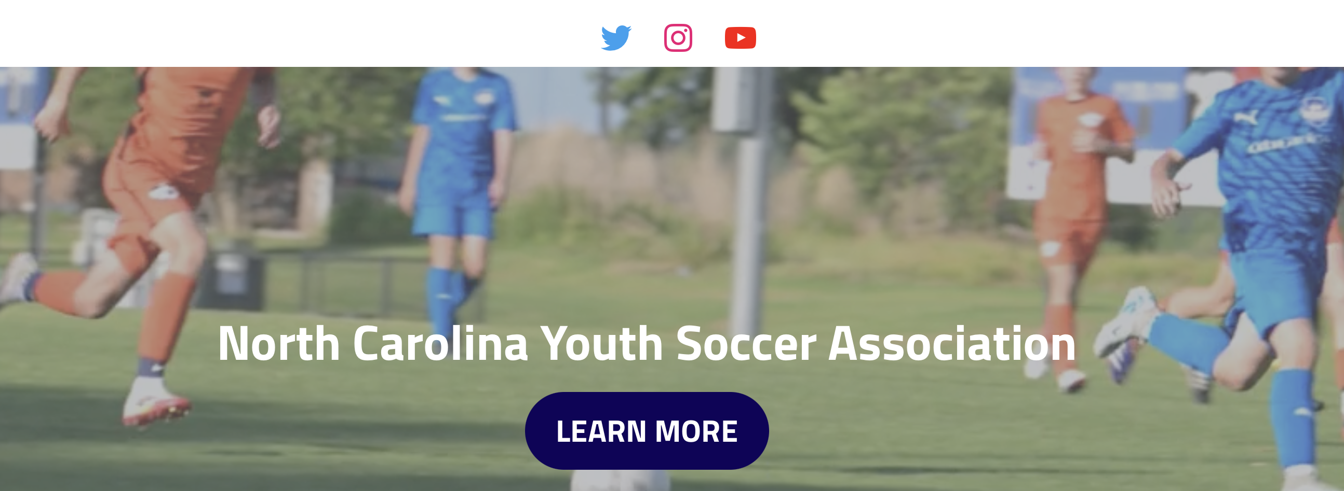
Information Available on NCYSA Website
I will provide a snapshot of the
webpage & how to access

Slide 19

Questions

